Slide 1
Introduction to Software Testing Lecture 10 Automated Test Generation
Instructor: Morteza Zakeri
Slides by: Morteza Zakeri
in Collaboration with Course Students
March 2024

Slide 2
Recap: Testing Software is Hard
If you are testing a bridge’s ability to sustain weight, and you test it with 1000 tons you can infer that it will sustain weight ≤ 1000 tons
This kind of reasoning does not work for software systems
Software systems are not linear nor continuous
Exhaustively testing all possible input/output combinations is too expensive
the number of test cases increase exponentially with the number of input/output variables

Slide 3
Where are we?
Lecture | Topic | Tools
L01-L04 | Introduction: Why test, Type of tests, Test automation, and Agile test | JUnit, NUnit
L05-L09 | Functional testing (Verification), Criteria-Based Testing | Graph Coverage, Data Flow Coverage, Domain Coverage, CodA
L10 | Automated test generation (Symbolic Execution, Concolic Execution, and Taint analysis, Search-based testing) | CREST, CROWN, KLEE, JDART, Triton, EvoSuite, Randoop
L11 | GUI (Desktop and Web Applications) testing | Selenium, Katalon Studio, GUITAR,
L12 | Performance testing (Load, Stress) | JMeter
L13 | Security (penetration) testing | Burp Suite, Acunetix
L14 | Negative testing (Fuzzing) | AFL, Peach, FileFuzz, DeepFuzz
Notes:
https://github.com/swtv-kaist/CROWN
https://github.com/jburnim/crest
https://github.com/JonathanSalwan/Triton
https://sourceforge.net/projects/guitar/
https://katalon.com

Slide 4
What is Automated Test Generation
Automated testing refers to the techniques which generate the test sets (test data and/or test oracles + test codes) automatically.
Paper: Automated software test generation: Some challenges, solutions, and recent advances
Paper: Survey on test data generation tools

Slide 5
Generating Test Cases Randomly
If we pick test data randomly it is unlikely that we will pick a case where x and y have the same value
If x and y can take 2³² different values, there are 2⁶⁴ possible test cases. In 2³² of them x and y are equal
probability of picking a case where x is equal to y is 2⁻³²
It is not a good idea to pick the test cases randomly (with uniform distribution) in this case
So, naive random testing is pretty hopeless too.
Various input probability distributions can be used.
bool isEqual(int x, int y)
{
if (x = y)
z := false;
else
z := false;
return z;
}

Slide 6
Automated Test Data Generation: Techniques, tools, and research papers
Adaptive random testing
Related tool(s): ARTGen, Randoop, …
Related paper(s): A survey on adaptive random testing
Symbolic and concolic execution
Related tool(s): JDART, KLEE, CROWN, …
Related paper(s): A survey of symbolic execution techniques
Search-based test data generation
Related tool(s): EvoSuite, Pynguin, …
Related paper(s): An extensive evaluation of search-based software testing: a review

Slide 7
Adaptive random testing

Slide 8
About ART
Adaptive Random Testing (ART) is a software testing method that improves upon traditional random testing by increasing efficiency and coverage. The primary goal of ART is to reduce the number of tests required to find defects compared to conventional random testing. This method uses various algorithms and strategies to select tests in a way that uniformly covers the test space, thereby increasing the likelihood of detecting faults.
In traditional random testing methods, tests are selected completely randomly without considering the positions of previous tests.

Slide 9
Traditional Random Testing
In Traditional Random Testing, tests are selected randomly without considering specific positions or characteristics. Typically, tests are chosen randomly from the input space without regard to the type of input or the system's previous state.
In this method, tests are often selected based on generating random numbers or other methods utilizing random events. A large number of tests are usually executed in hopes of achieving comprehensive coverage of the input space. While this approach is often fast and straightforward to implement, it may have limited effectiveness in uncovering hidden defects or weaknesses in the software.

Slide 10

Example
For example, in a web application, Traditional random testing might randomly fill in input forms and click buttons without considering common user interactions or important scenarios that could occur.
Let's Check the codes

Slide 11
The key advantages of ART
Improved Fault Detection Capability: By generating diverse test cases that explore different regions of the input domain, ART is more likely to uncover a wider range of defects.
Early Fault Detection: The adaptive nature of ART allows it to focus on unexplored regions of the input domain, leading to the earlier detection of faults.
Reduced Test Suite Size: ART can achieve the same level of fault detection with a smaller number of test cases compared to random testing, as it avoids redundant test cases.

Slide 12
(ART) strategies & algorithms
Adaptive Random Testing (ART) encompasses several strategies and algorithms, each with different methods for selecting test inputs. Here are some well-known ART strategies:

Slide 13
(ART) strategies & algorithms
1. Feedback-Directed ART (FD-ART)
Feedback-Directed Adaptive Random Testing (FD-ART) is a hybrid testing approach that combines the principles of Adaptive Random Testing (ART) and feedback-directed test generation. The goal is to enhance the effectiveness and efficiency of the testing process by leveraging execution feedback to guide the generation of diverse and fault-revealing test cases.

Slide 14
(ART) strategies & algorithms
Relation to Randoop
Randoop is a tool for automated test generation for Java programs that exemplifies feedback-directed test generation. It aligns with the FD-ART approach by:
Generating Initial Tests: Starts with random sequences of method and constructor calls.
Collecting Feedback: Executes these sequences and collects feedback on exceptions, contract violations, and other behaviors.
Guiding Test Generation: Uses feedback to adaptively generate new test sequences, focusing on fault-revealing areas and ensuring test diversity.

Slide 15
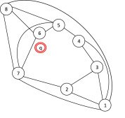
(ART) strategies & algorithms
2. Fixed Size Candidate Set (FSCS)
In this strategy, a fixed-size set of candidate inputs is initially selected randomly. Then, the input that is the furthest away from the previously selected inputs is chosen. This process ensures a more uniform distribution of inputs across the input space.
3. Distance-based ART (D-ART)
This strategy is based on the distance between inputs. In D-ART, random inputs are first selected, and then their distance from previously selected inputs is calculated. The input with the greatest distance from the others is chosen. This method also aims to increase the coverage of the input space and enhance input diversity.

Slide 16
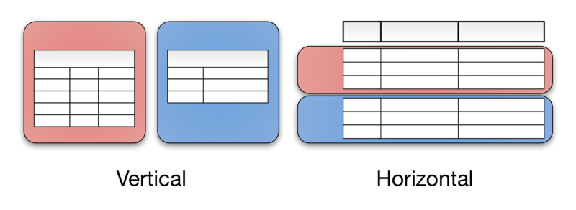
(ART) strategies & algorithms
4. Grid-based ART
In this strategy, the input space is divided into a grid, and an input is selected from each cell of the grid. This approach ensures that inputs are more uniformly distributed across the input space and different areas of the space are covered.
5. Partition-based ART
The input space is divided into several partitions, and then a random input is selected from each partition. This method aims to increase the coverage of the input space and prevent inputs from concentrating in a specific area.

Slide 17
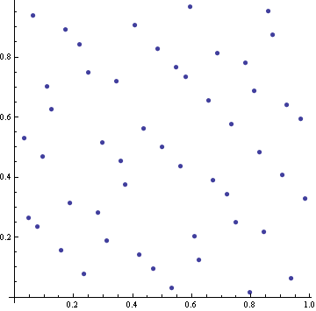
(ART) strategies & algorithms
6. Quasi-random ART
This method uses quasi-random sequences to select inputs. Quasi-random sequences have a more uniform distribution compared to purely random sequences, making them more suitable for ART.

Slide 18
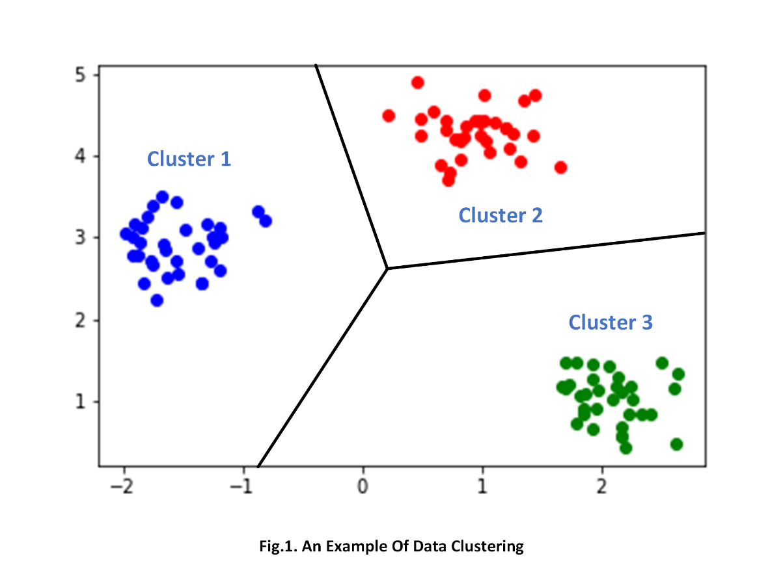
(ART) strategies & algorithms
7. Clustering-based ART
In this strategy, the input space is first divided into clusters, and then a random input is selected from each cluster. This method increases the diversity of inputs and improves the coverage of the input space.

Slide 19
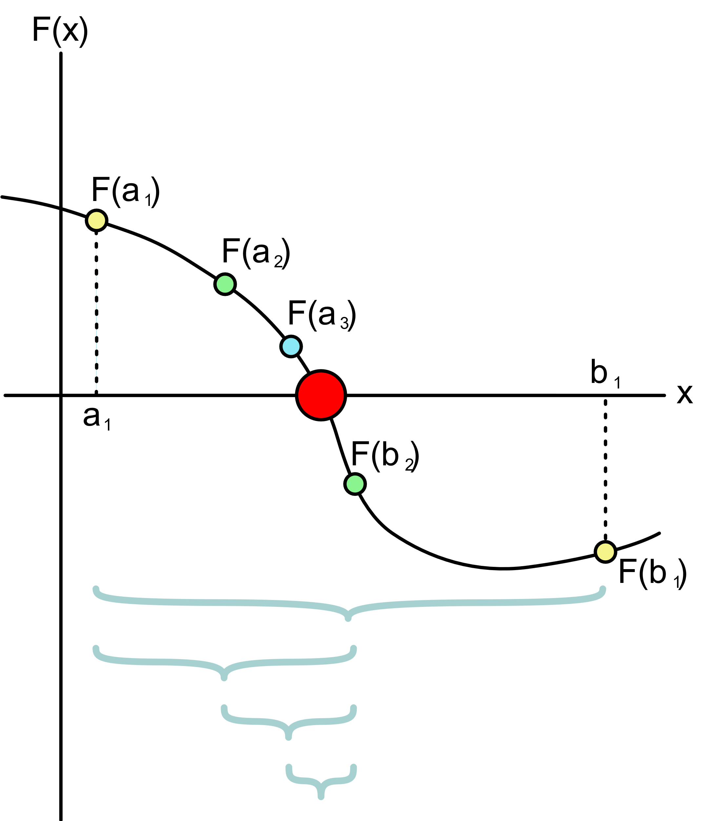
(ART) strategies & algorithms
8. Adaptive Random Testing by Bisection (ART-B)
This strategy uses the bisection of the input space to select inputs. The input space is repeatedly divided into smaller sections, and an input is selected from each section to increase input diversity and coverage.
Conclusion
Different ART strategies aim to improve the efficiency of random testing by more uniformly distributing and intelligently selecting inputs. The appropriate strategy depends on the type of system under test, the complexity of the input space, and the available computational resources.

Slide 20
Example
Let's consider an example of Adaptive Random Testing using the Fixed Size Candidate Set (FSCS) algorithm. This example will demonstrate how ART can be applied to test a software system with a two-dimensional input space.
Example: Testing a Function with a 2D Input Space
Suppose we have a function f(x, y) that we want to test. The input space for f is defined as a 2D space where x and y both range from 0 to 100. Our goal is to find faults in the function by using ART.

Slide 21
Example
Step-by-Step Process
Step 1: Initial Random Selection
Select the first input randomly from the entire input space.
Let's say the first input is (20,30)

Slide 22
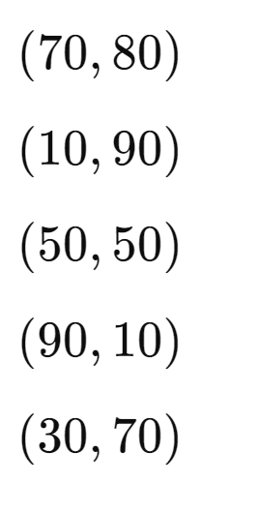
Example
Step 2: Generate Candidate Inputs
Generate a fixed-size set of candidate inputs randomly. Suppose we decide to use 5 candidates.
The candidate inputs might be:

Slide 23
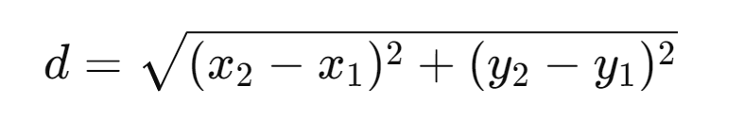
Example
Step 3: Calculate Distances
Calculate the distance of each candidate input from the previously selected input(s). For simplicity, we'll use the Euclidean distance formula:

Slide 24
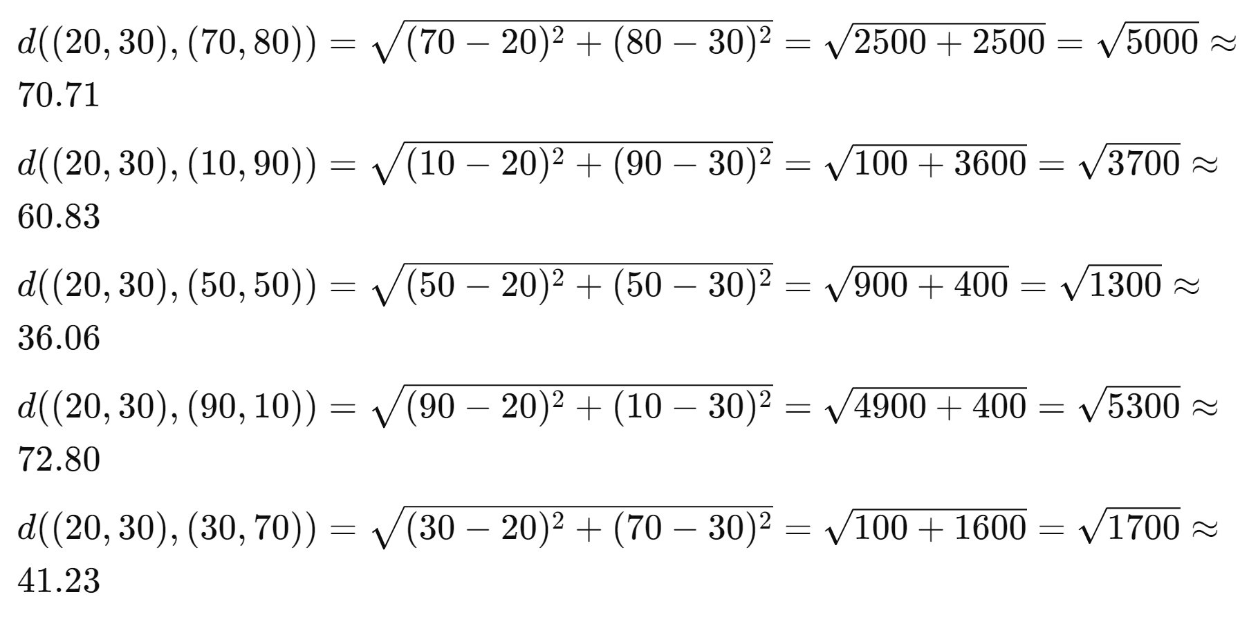
Example
Step 3: Calculate Distances
Distances from (20,30) to each candidate:

Slide 25
Example
Step 4: Select the Farthest Candidate
The candidate with the greatest distance from (20,30) is (90,10) with a distance of approximately 72.80.
Select (90,10) as the next input.
Step 5: Repeat the Process
Continue the process by generating new candidate inputs and selecting the one that is farthest from all previously selected inputs.

Slide 26
Example
Summary
This example demonstrates how the FSCS algorithm in ART works by iteratively selecting inputs that are farthest from previously selected ones. This helps in achieving a more uniform coverage of the input space compared to purely random testing, thereby improving the chances of finding faults.

Slide 27
What is randoop?
Randoop is a unit test generator for Java. It automatically creates unit tests for your classes, in JUnit format.
Randoop generates unit tests using feedback-directed random test generation. This technique pseudo-randomly, but smartly, generates sequences of method/constructor invocations for the classes under test. Randoop executes the sequences it creates, using the results of the execution to create assertions that capture the behavior of your program. Randoop creates tests from the code sequences and assertions.
Randoop outputs two kinds of tests:
error-revealing tests that detect bugs in your current code, and
regression tests that can be used to detect future bugs.

Slide 28
Typical use of Randoop
Here is a typical way to use Randoop:
If Randoop outputs any error-revealing tests, fix the underlying defects, then re-run Randoop and repeat until Randoop outputs no error-revealing tests.
Add the regression tests to your project's test suite.
Run the regression tests whenever you change your project. These tests will notify you of changes to the behavior of your program.
If any test fails, minimize the test case and then investigate the failure.
If a test failure indicates you have introduced a code defect, fix the defect.
If a test failure indicates that the test was overly brittle or specific (for example, a method's output value has changed, but the new value is as acceptable as the old value), then disregard the test.

Slide 29
Typical use of Randoop
If you disregarded any test (or if you added new code that you would like to test), then re-run Randoop to generate a new regression test suite that replaces the old one.
The paper "Scaling up automated test generation: Automatically generating maintainable regression unit tests for programs" gives additional tips for how to use Randoop-generated tests over the lifetime of a project.
A typical programmer will only ever examine very few Randoop tests - when they fail and reveal a bug or a regression failure - and then only minimized versions of them. A typical programmer will never modify Randoop tests by hand.

Slide 30
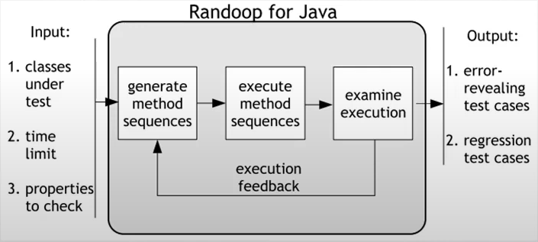
The idea behind randoop
Randoop generates unit test cases using feedback_directed randoom testing.
To avoid generating redundant and illegal inputs.
Randoop creates method sequences incrementally. By randomly selecting a method call to apply and selecting arguments from previously constructed sequences.
As soon as it is created, a new sequence is executed and checked against a set of contracts:
Sequences that lead to contract violations are output to the user as error revealing tests.
Sequences that exhibited normal behavior are output as regression tests.

Slide 31
Installing & Running Randoop
Randoop runs on a Java 8 or later JVM.
Download and unzip the file in randoop github. This manual uses ${RANDOOP_PATH} to refer to the path of the unzipped archive, and ${RANDOOP_JAR} to refer to the location of randoop-all-4.3.3.jar within the unzipped archive.
Run Randoop by invoking its main class randoop.main.Main:
java randoop.main.Main command args...

Slide 32
Installing & Running Randoop
Randoop supports three commands:
gentests generates unit tests. Example use:
java -Xmx3000m -classpath myclasspath:${RANDOOP_JAR} randoop.main.Main gentests --testclass=java.util.TreeSet --output-limit=100
)However, note that it is extremely unusual to use the --testclass command-line argument to specify just one class under test (
minimize minimizes a failing JUnit test suite. Example use:
java -cp ${RANDOOP_JAR} randoop.main.Main minimize --suitepath=ErrorTest0.java --suiteclasspath=myclasspath

Slide 33
Installing & Running Randoop
help prints out a usage message. Example uses:
java -classpath ${RANDOOP_JAR} randoop.main.Main help
java -classpath ${RANDOOP_JAR} randoop.main.Main help gentests
java -classpath ${RANDOOP_JAR} randoop.main.Main help minimize
(On Windows, adjust the classpath, such as using semicolon instead of colon as the separator.)

Slide 34
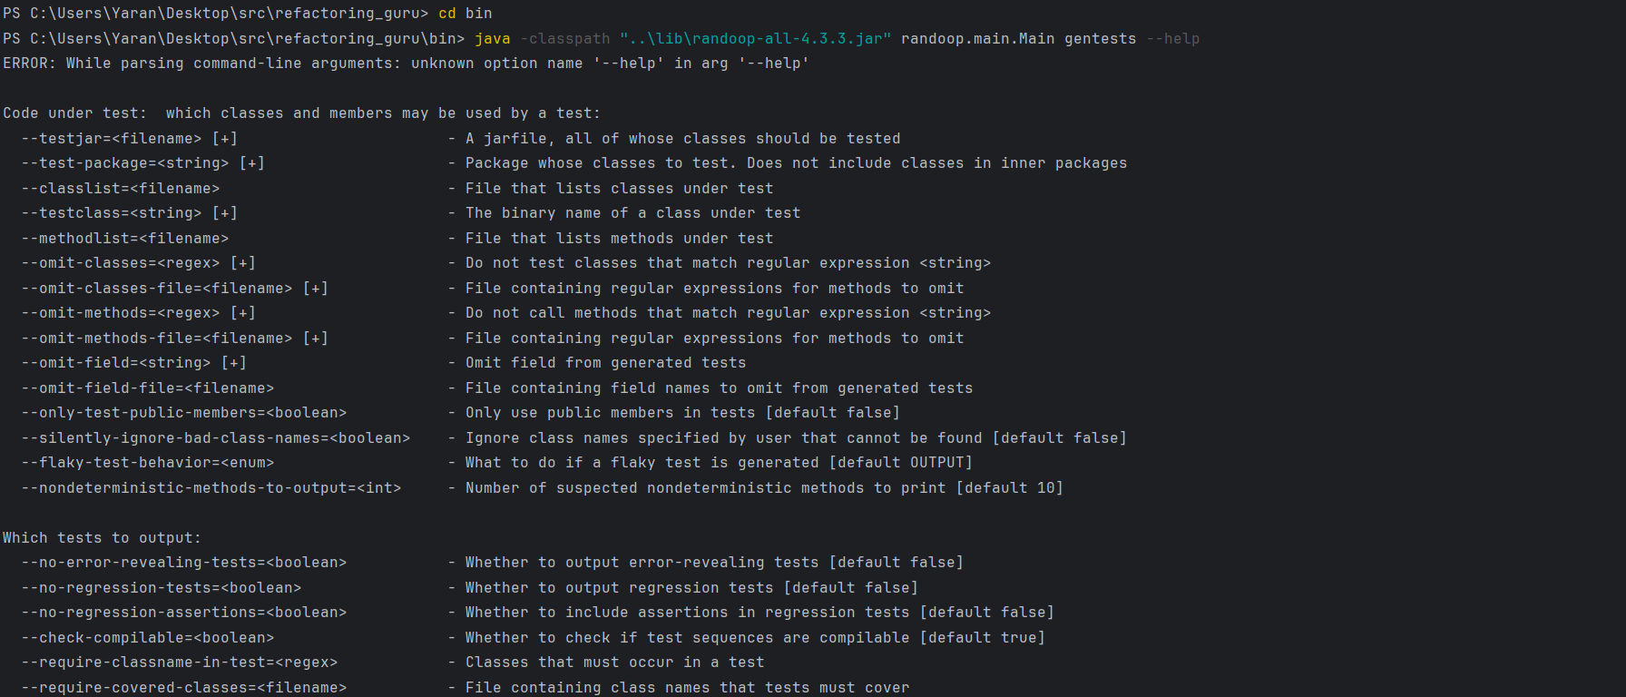
Installing & Running Randoop
help prints out a usage message. In car builder project in bin folder:
java -classpath "..\lib\randoop-all-4.3.3.jar" randoop.main.Main gentests --help

Slide 35
Generating tests
By default, Randoop generates and then outputs two kinds of unit tests, written to separate files.
Error-revealing tests are tests that fail when executed, indicating a potential error in one or more classes under test.
Regression tests are tests that pass when executed, and can be used to augment a regression test suite.
Other generated tests, classified as invalid, are discarded.

Slide 36
Generating tests
For testing Only one class with Randoop with a specific directory to write test suites and specific time limit:
java -classpath "..\out\production\design-patterns-java-main\refactoring_guru\builder\example\builders;..\lib\randoop-all-4.3.3.jar" randoop.main.Main gentests --testclass="builder.builders.CarBuilder" --junit-output-dir="..\refactoring_guru\test" --time-limit=5

Slide 37
Generating tests
For testing with a class list with a specific directory to write test suites and specific time limit:
java -classpath "..\out\production\design-patterns-java-main;..\lib\randoop-all-4.3.3.jar" randoop.main.Main gentests --classlist="..\out\myclasslist.txt" --junit-output-dir="..\refactoring_guru\test" --time-limit=5

Slide 38
When to use randoop
When you have an application that has no junit test suite written for it and you need to test it.
When you need to see know the logical mistakes in your code by generating error revealing tests.
When you need a regression test suite to run after each change or modification in the code by you
When you are working with TDD (test driven development) and you started with development and forget the testing

Slide 39
ARTGen
ARTGen is a tool designed to implement Adaptive Random Testing (ART) techniques, which aim to improve the effectiveness of random testing by distributing test cases more evenly across the input domain. ART methods, such as the Fixed-Size-Candidate-Set ART (FSCS-ART), enhance fault detection by ensuring a more uniform spread of test inputs, thereby increasing the likelihood of uncovering software defects. ARTGen leverages these principles to generate diverse and effective test cases, making it a valuable asset in software testing for identifying failure-causing inputs more efficiently.

Slide 40
References
Chen, T. Y., & Merkel, R. G. (2008). "An upper bound on software testing effectiveness." ACM Transactions on Software Engineering and Methodology (TOSEM), 17(3), 16.
Chen, T. Y., & Huang, D. T. (2013). "Adaptive Random Testing: The ART of test case diversity." CRC Press.
Chen, T. Y., Kuo, F. C., Merkel, R. G., & Tse, T. H. (2004). "Adaptive Random Testing: The ART of test case diversity." Journal of Systems and Software, 83(1), 60-66.
Chan, K. P., Cheung, S. C., & Chen, T. Y. (1996). "Proportional sampling strategy: Guidelines for generating representative failure samples." Information and Software Technology, 38(11), 775-782.
Xu, X., & Parnas, D. L. (1990). "On the effectiveness of random testing." Proceedings of the 2nd IEEE International Conference on Software Engineering, pp. 20-26.
GitHub - randoop/randoop: Automatic test generation for Java

Slide 41
Questions1
Question 1:
What is the main objective of Adaptive Random Testing (ART)?
Answer: The main objective of Adaptive Random Testing (ART) is to improve the efficiency of random testing by ensuring a more uniform distribution of test inputs across the input space. This increases the likelihood of detecting faults by selecting inputs that are more diverse and evenly spread out.

Slide 42
Questions2
Question 2:
Name the strategies and algorithms of ART?
Answer:
1. Feedback-Directed ART (FD-ART)
2. Fixed Size Candidate Set (FSCS)
3. Distance-based ART (D-ART)
4. Grid-based ART
5. Partition-based ART
6. Quasi-random ART
7. Clustering-based ART
8. Adaptive Random Testing by Bisection (ART-B)

Slide 43
Questions3
Question 3:
How does the Fixed Size Candidate Set (FSCS) strategy work in ART?
Answer: In the Fixed Size Candidate Set (FSCS) strategy, a fixed-size set of candidate inputs is initially selected randomly. Then, the input that is the furthest away from the previously selected inputs is chosen. This process ensures a more uniform distribution of inputs across the input space.

Slide 44
Symbolic and concolic execution

Slide 45
Introduction
In computer science, symbolic execution is a means of analyzing a program to determine what inputs cause each part of a program to execute
Symbolic execution explores multiple execution paths at the same time. If a program is run concretely, that is, on a specific concrete input, a single control flow path of this program is explored
Symbolic execution is used to reason about a program path-by-path which is an advantage over reasoning about a program input-by-input as other testing paradigms use
Concolic means Having elements of both concrete (normal) and symbolic processing

Slide 46
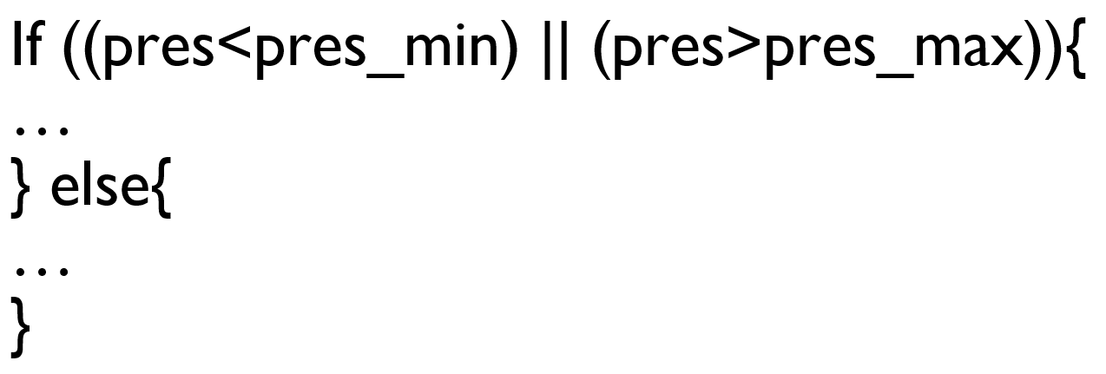
Symbolic Execution
If ((pres<pres_min) || (pres>pres_max)){ … } else{ … }
pres = 460; pres_min=640; pres_max=960

Slide 47
Symbolic Execution
If ((pres<pres_min) || (pres>pres_max)){ … } else{ … }
pres = Sym; pres_min=MIN; pres_max=MAX
[Path condition 1: Sym<MIN]

Slide 48
Symbolic Execution
If ((pres<pres_min) || (pres>pres_max)){ … } else{ … }
pres = Sym; pres_min=MIN; pres_max=MAX
[Path condition 2: Sym>MAX]

Slide 49
Symbolic Execution
If ((pres<pres_min) || (pres>pres_max)){ … } else{ … }
pres = Sym; pres_min=MIN; pres_max=MAX
[Path condition 3: Sym>=MIN && Sym<=MAX]

Slide 50
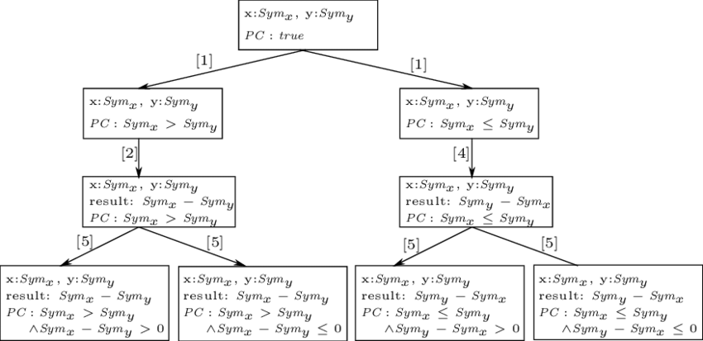
Symbolic Execution
Symbolic Execution Tree example:

Slide 51
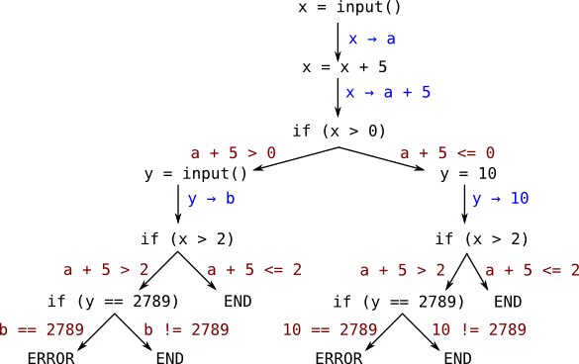
Concolic Execution
Concolic Execution Tree example:

Slide 52
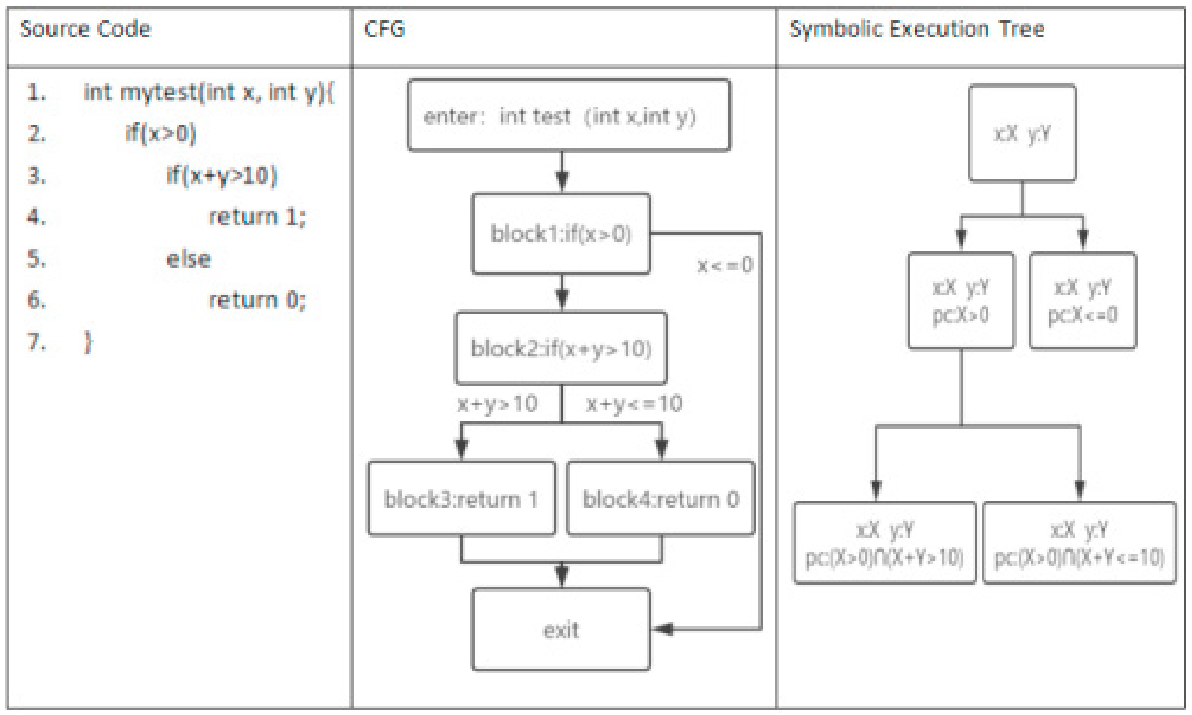
Difference of CFG and SET

Slide 53
Symbolic Execution
Analysis of programs with unspecified inputs
Execute a program on symbolic inputs
Symbolic states represent sets of concrete states
For each path, build a path condition
Conditions on inputs: for the execution to follow that path
Check path condition satisfiability: explore only feasible paths
Symbolic state
Symbolic values/expressions for variables
Path conditions
Program counter

Slide 54
not to use Symbolic execution!
Performing symbolic execution on looping programs
May result in an infinite execution tree
Perform search with limited depth to avoid an infinite execution tree
When you have many merge points – conditional where the test-expression itself is symbolic
You end up with the usual combinatiorial explosion and your SAT/SMT solver will struggle to handle all the combinations
In such cases people usually prefer to use “directed automated random testing” in combination with symbolic testing instead
Notes:
SAT: Site Acceptance Testing
SMT: Satisfiability Modulo Theory

Slide 55
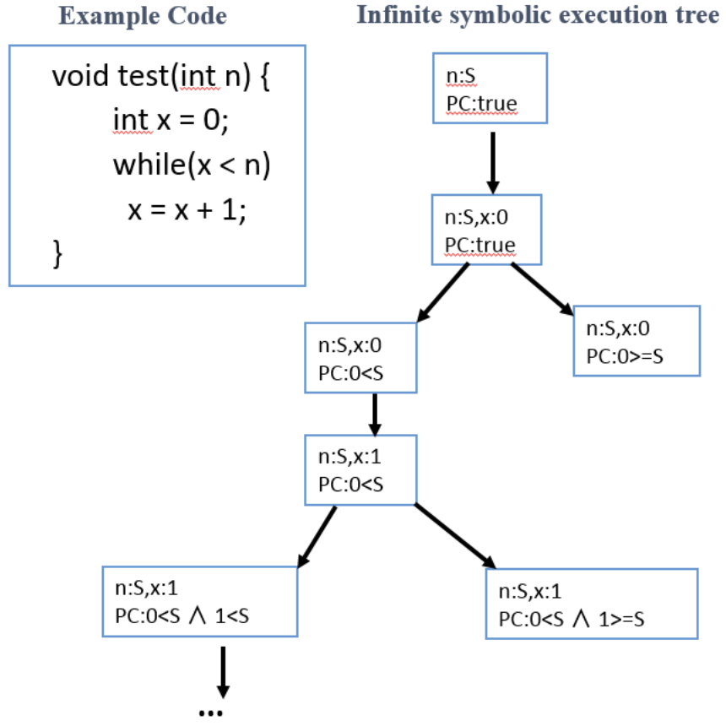
not to use Symbolic execution!
Notes:
SAT: Site Acceptance Testing
SMT: Satisfiability Modulo Theory

Slide 56
What is Klee
KLEE is a dynamic symbolic execution engine designed to analyze and test software by executing it with symbolic inputs
KLEE operates on LLVM bitcode, allowing it to analyze a wide range of software
executes the program symbolically
generates path constraints
solves the constraints
Execute and find errors

Slide 57
KLEE Goal
hit every line of executable code in the program
detect any potential input values that could lead to errors during risky operations such as dereferencing, assertions, segmentation, division

Slide 58
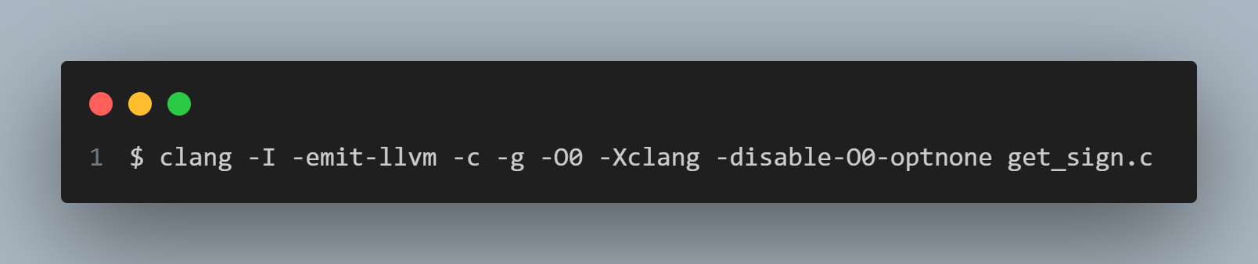
Usage
1. Compiling to LLVM bitcode
clang -emit-llvm: compile the app to llvm bitcode
-I: used so that the compiler can find <klee/klee.h>
-g: to add debug information to the bitcode file
-O0 -Xclang -disable-O0-optnone: KLEE optimization

Slide 59

Usage
2. Running KLEE

Slide 60
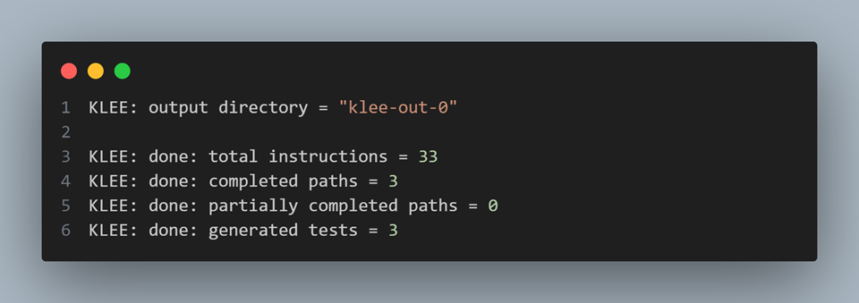
Usage
3. output

Slide 61
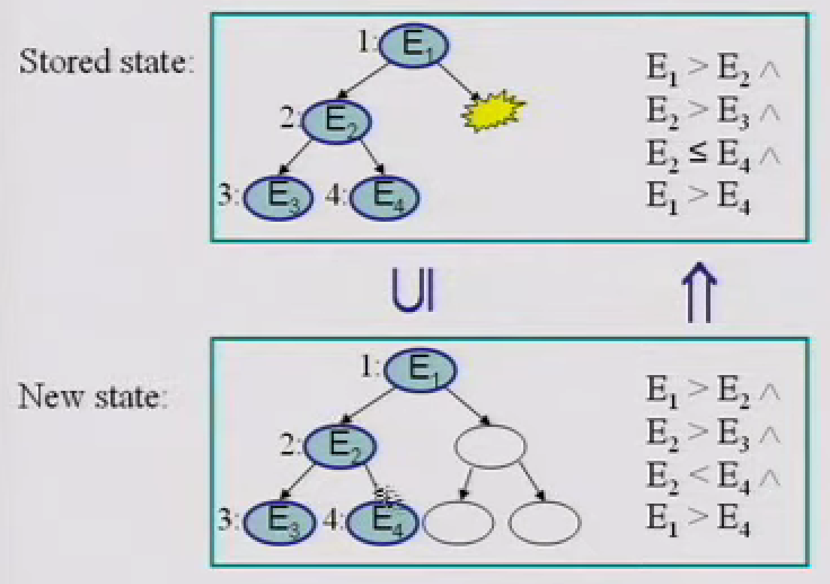
How to improve state numbers?
State Matching: Subsumption Checking
Obtained through DFS traversal of “rooted” heap configurations
Roots are program variables pointing to the heap

Slide 62
How to improve state numbers?
Abstract subsumption
Abstraction
Store abstract versions of explored symbolic states
Subsumption checking to determine if an abstract state is re-visited
Decide if the search should continue or backtrack
Preserves errors to safety properties/useful for testing

Slide 63
How to improve state numbers?
Shape abstraction for linked lists
Summarize contiguous list elements not pointed to by program variables into summary nodes
Valuation of summary node
Union of valuations of summarized nodes
Subsumption checking between abstracted states
Treat summary node as an ordinary node
Abstraction for arrays
Represent array as a linked list
Abstraction similar to shape abstraction for linked lists

Slide 64
Key challenges and solutions
Lifting to Intermediate Representation (IR): To address the complexity of native instructions and support multiple architectures, symbolic executors transform native instructions into an IR, like VEX or LLVM-IR, which simplifies program analysis.
Control Flow Graph (CFG) Reconstruction: There are techniques for reconstructing CFGs from binaries, which is challenging due to indirect jumps and the dynamic nature of binary execution.
Code Obfuscation: Th impact of code obfuscation on symbolic execution, noting that obfuscation is used to hinder analysis and can lead to imprecision or excessive resource usage.
Notes:
VEX is a RISC-like language designed for program analysis that offers a compact set of instructions to express programs in static single assignment form

Slide 65
CFG Reconstruction
Challenges in CFG Reconstruction:
Indirect Jumps: The targets of indirect jumps are determined at runtime, making them difficult to predict statically.
Iterative Refinement: CFG reconstruction is an iterative process that refines the graph using various program analysis techniques.
Techniques Used:
Value-Set Analysis (VSA): This technique over-approximates certain program state properties, like possible targets of an indirect jump.
Initial CFG Generation: An initial CFG is created with special nodes for unresolved indirect jump targets, akin to widening a fact to the bottom of a lattice in dataflow analysis.
On-Demand VSA: When more precise information is required, VSA is applied to refine the CFG.
Notes:
VEX is a RISC-like language designed for program analysis that offers a compact set of instructions to express programs in static single assignment form

Slide 66
Code Obfuscation
Challenges for Analysis:
Obfuscated code poses significant challenges for symbolic/concolic execution in program analysis due to the introduction of complexities that lead to imprecision or excessive resource usage.
Techniques:
Conditional Branch Transformation: Obfuscation tools may convert conditional branches into indirect jumps, complicating symbolic analysis.
Runtime Code Self-Modification: This technique can hide conditional jumps based on symbolic values, making them difficult to detect during analysis.
Use of Mathematical Conjectures: Some obfuscation techniques involve inserting loops based on unsolved mathematical conjectures, which eventually converge to a known value and are combined with the original branch condition.
Notes:
VEX is a RISC-like language designed for program analysis that offers a compact set of instructions to express programs in static single assignment form

Slide 67
Questions
What is Concolic execution? briefly explain each part of it.
Concolic execution is a type of execution that uses both Concrete and Symbolic execution methods
-Concrete execution is the normal method of executing a program with actual input values
-In computer science, symbolic execution is a means of analyzing a program using symbolic values to determine what inputs cause each part of a program to execute
Symbolic execution explores multiple execution paths at the same time.
Notes:
VEX is a RISC-like language designed for program analysis that offers a compact set of instructions to express programs in static single assignment form

Slide 68
Questions
2. In which cases should we avoid using symbolic execution?
- When you have many merge points – conditional where the test-expression itself is symbolic – You end up with the usual combinatiorial explosion and your SAT/SMT solver will struggle to handle all the combinations
- Performing symbolic execution on looping programs may result in an infinite execution tree
Notes:
VEX is a RISC-like language designed for program analysis that offers a compact set of instructions to express programs in static single assignment form

Slide 69
Questions
What are the difference of CFG and SET?
Control Flow Graph (CFG) represents a program's structure with nodes as basic blocks of code and edges as control flows between them. It analyzes and optimizes program flow by evaluating conditions within each block, independent of specific input values.
A Symbolic Execution Tree (SET) represents execution paths with nodes for program states and edges for symbolic conditions. It explores all possible paths, finds bugs, and generates test cases, determining constraint paths from the start to the current block. The tree may fork on dangerous operations to analyze different outcomes.
Notes:
VEX is a RISC-like language designed for program analysis that offers a compact set of instructions to express programs in static single assignment form

Slide 70
Refrences
[1] R. Baldoni, E. Coppa, D. C. D’elia, C. Demetrescu, and I. Finocchi, “A Survey of Symbolic Execution Techniques,” ACM Computing Surveys, vol. 51, no. 3, pp. 1–39, Jul. 2018
[2] Khurshid, Sarfraz and Pasareanu, Corina and Visser, Willem, “Generalized Symbolic Execution for Model Checking and Testing”, Jul.2003
[3] Cristian Cadar, D. Dunbar, and D. Engler, “KLEE: unassisted and automatic generation of high-coverage tests for complex systems programs,” pp. 209–224, Dec. 2008
Notes:
VEX is a RISC-like language designed for program analysis that offers a compact set of instructions to express programs in static single assignment form

Slide 71
Search-based software testing (SBST)

Slide 72
Search-Based Software Testing (SBST)
Search-Based Software Testing is the use of a meta-heuristic optimizing search technique, such as a Genetic Algorithm, to automate or partially automate a testing task
for example the automatic generation of test data
Key to the optimization process is a problem-specific fitness function
The role of the fitness function is to guide the search to good solutions from a potentially infinite search space, within a practical time limit

Slide 73
Search-Based Software Testing (SBST)
The most important part: The conversion of test criteria to objective functions is required for test data generation
Objective tasks compare and contrast results of the search with respect to the all search goal lines

Slide 74
Genetic Algorithm
Genetic algorithm is a heuristic method, one of the types of the evolutionary algorithms
Its goal is not to find the optimal and best solution, but to find one that is close enough to it
A genetic algorithm is considered completed if a certain number of iterations are, or if the satisfactory value of the fitness function was obtained
Generally, the genetic algorithm solves the problem of maximizing or minimizing, and the adequacy of each decision (chromosome) is assessed using the fitness function

Slide 75
Genetic Algorithm
GA works according by the following principle:
Initializing: Establishing fitness function. Forming the initial population. The initial population is created by random filling of genes in the chromosomes
Evaluation of population: Each of the chromosomes is evaluated by the fitness function
Selection: After each chromosome obtain its own value, the selection of the best chromosomes takes place. Selection can be done by different methods
For example, take the first n chromosomes sorted by value of the fitness function, or only chromosomes with maximum value of the fitness function, etc

Slide 76
Genetic Algorithm
Crossover: After selection and retrieving the suitable chromosomes to solve the problem, they crossover with each other. Crossover occurs based on the selection of a specific position in the two chromosomes (crossover point) and mutual replacement of parts.
Mutation: In random order, a random gene can change values to a random one
The main goal of mutation is to obtain solutions that could not be produced with existing genes. This will allow, firstly, to avoid falling into local extremes, since the mutation may allow the algorithm to go a completely different path, and secondly, to “dilute” the population in order to avoid a situation where there are only identical chromosomes in the entire population that will not move towards a global solution

Slide 77
Genetic Algorithm
After all stages of the genetic algorithm have been completed, it is estimated whether the population has reached the desired accuracy of the solutions, or whether a certain number of populations have been reached. If these conditions have been met, the algorithm stops working. Otherwise, the cycle is repeated with the new population until the conditions are reached

Slide 78
Assigning Weights
Search for a single path in the program code works as follows:
The first operation is assigned a weight, for example, 100.
Each subsequent operation is also assigned a weight – if there are no conditions or cycles, the weight is equal to the weight of the previous operation
Weight of the condition is assigned in accordance with the following rule. If the condition contains only one branch (only if ...), then the weight of each operation is reduced on 0.8. If the condition is divided into several branches (if ... else ...), then the weight is divided into equivalent parts - for two branches 50 / 50, for three 33 / 33 / 33, etc
Weights of operations in the cycle remain the same, but can also be multiplied by a certain weight, if it is necessary to increase the significance of the cycles during testing

Slide 79
Assigning Weights
All nested restrictions are taken into account, for example, for two nested conditions, the weight of operations will be equal to 80 * 80 = 64 percent

Slide 80
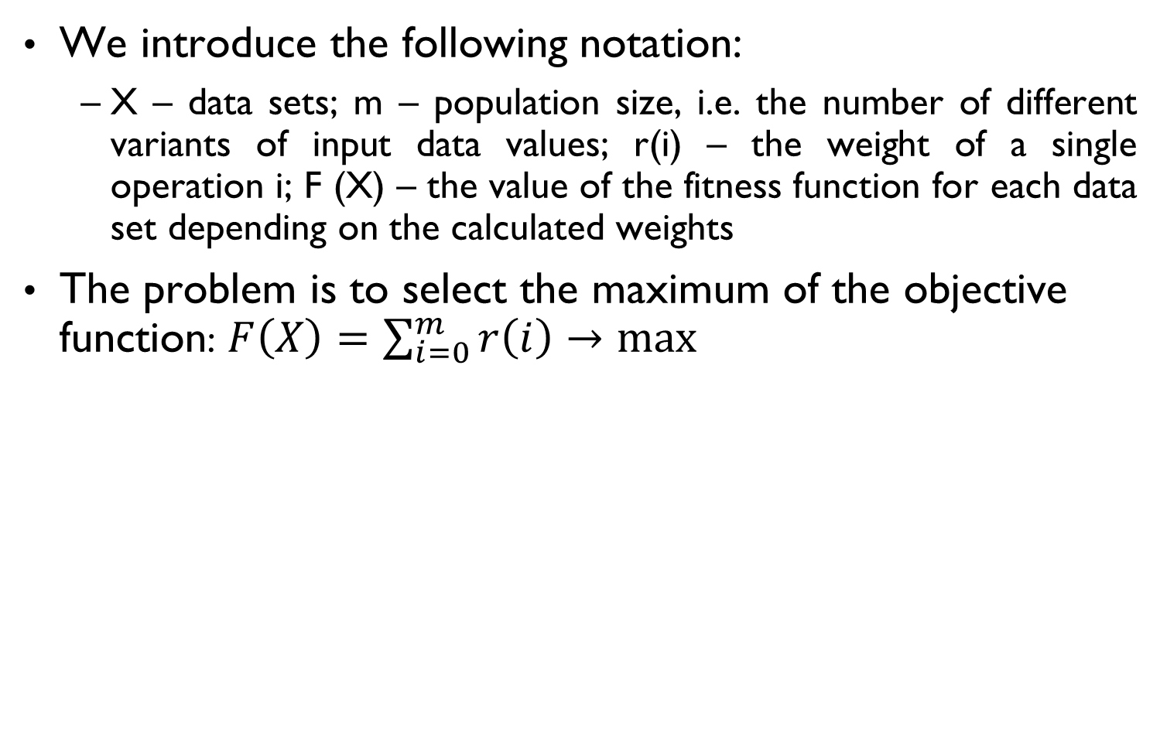
Test data generation with GA
We introduce the following notation:
X – data sets; m – population size, i.e. the number of different variants of input data values; r(i) – the weight of a single operation i; F (X) – the value of the fitness function for each data set depending on the calculated weights
The problem is to select the maximum of the objective function: $F\left(X\right)=\sum_{i=0}^{m}{r\left(ⅈ\right)}→max$

Slide 81
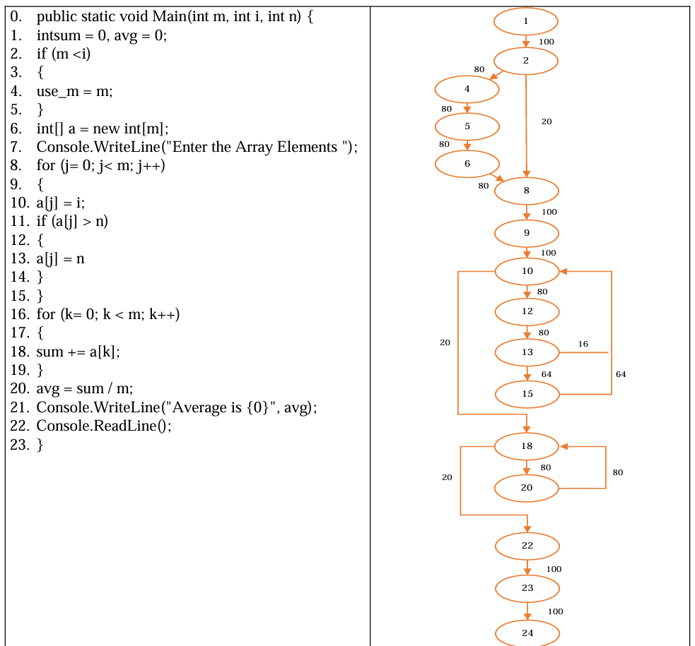
Test data generation with GA

Slide 82
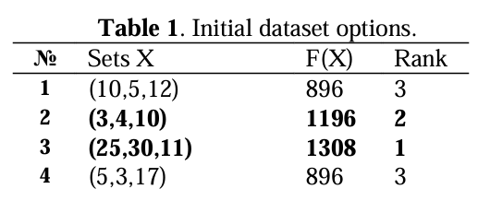
Test data generation with GA
At the initialization stage we will generate the following data sets – (10,5,12); (3,4,10); (25,30,11); (5,3,17).
Table 1 presents these sets, the calculated target value of the fitness function and the rank corresponding to the best set
From the table we can see that the better options for the selection are 2nd and 3rd options. In order to obtain additional two new variants, their values will be mixed with a certain probability of mutation

Slide 83
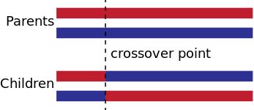
Test data generation with GA
One-point crossover
A point on both parents' chromosomes is picked, and designated a 'crossover point’. Genes to the right of that point are swapped between the two parent chromosomes. This results in two offspring, each carrying some genetic information from both parents.

Slide 84
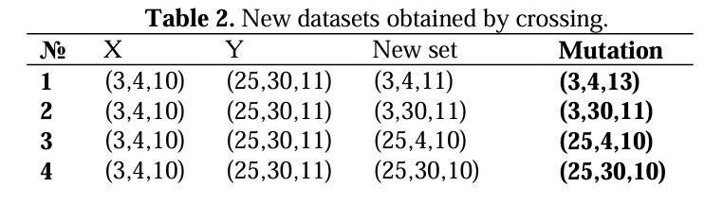
Test data generation with GA
In the crossover stage the division of data sets occur after the first and second positions. For example, when crossing (R1, R2, R3) and (G1, G2, G3), the variables obtained are - (R1, R2, G3), (R1, G2, G3), (G1, G2, R3) and (G1, R2, R3)
Depending on the settings of the genetic algorithm, the parental chromosomes can be excluded from consideration

Slide 85
Test data generation with GA
Mutation will occur with a probability of 0.1 for the chance of changing the value from 1 to the specified value in both directions. Under these conditions, the maximum possible value added during a mutation is 5

Slide 86
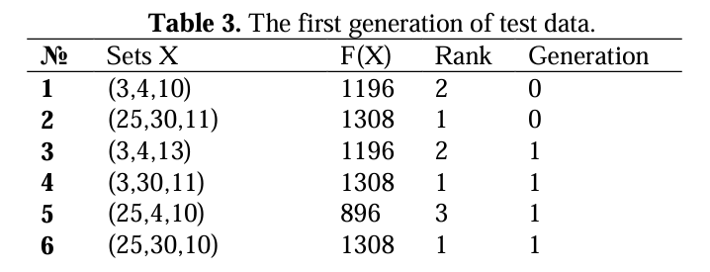
Test data generation with GA
As a result, two more variants will be added to the additional two parent sets - (3,4,13) and (25,30,10)
If the two variants have the same rank, priority will be given to the option from the newer generation
The first set was obtained from the first generation, so it will be excluded and there will remain only two options - (3,30,11) and (25,30,10)

Slide 87
Hill Climbing
A local search optimization algorithm used in Artificial Intelligence (AI)
Starts with an initial solution and iteratively makes small changes to improve it
Relies on a heuristic function to evaluate the quality of the solution
Continues until a local maximum is reached, where no further improvement is possible

Slide 88
Hill Climbing
Variations:
Steepest Ascent: Evaluates all possible moves from the current solution and selects the best improvement
First-Choice: Randomly selects a move and accepts it if it leads to an improvement
Simulated Annealing: Accepts worse moves occasionally to avoid local maxima

Slide 89
Hill Climbing Algorithm
Advantages:
Simple and intuitive, easy to understand and implement
Efficient in finding local optima quickly
Can be modified to include additional heuristics or constraints
Disadvantages:
May get stuck in local optima, missing the global optimum
Sensitive to the choice of initial solution
Does not explore the search space thoroughly, which can limit its effectiveness

Slide 90
State Space diagram
The state-space diagram is a graphical representation of the set of states our search algorithm can reach vs the value of our objective function(the function which we wish to maximize)
X-axis: denotes the state space ie states or configuration our algorithm may reach
Y-axis: denotes the values of objective function corresponding to a particular state
The best solution will be a state space where the objective function has a maximum value (global maximum)

Slide 91
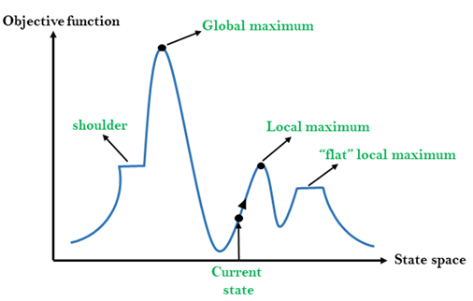
State Space diagram

Slide 92
Simulated Annealing
Simulated Annealing Algorithm:
A probabilistic optimization algorithm inspired by the annealing process in metallurgy
It involves heating and cooling a material to increase the size of its crystals and reduce defects
Mechanism:
Starts with a high “temperature” to allow exploration of the solution space
Gradually lowers the temperature to reduce the probability of accepting worse solutions
Aims to find a global optimum by escaping local optima

Slide 93
Simulated Annealing
Advantages:
Can escape local optima, increasing the chance of finding a global optimum
Flexible and adaptable to various types of optimization problems
Disadvantages:
Requires careful tuning of parameters like initial temperature and cooling schedule
Performance can be unpredictable and may require multiple runs to find a good solution

Slide 94
Pynguin
Pynguin is an automated unit test generation framework for Python
The easiest way to obtain Pynguin is by running this command:
pip install pynguin
We invoke Pynguin to let it generate test cases
We use \ and the line breaks for better readability here, you can just omit them and type everything in one line:
pynguin \
--project-path ./source \
--output-path ./pynguin-results \
--module-name example

Slide 95

Pynguin
To have some more verbose output we add the -v parameter:
pynguin \
--project-path ./source \
--output-path ./pynguin-results \
--module-name example \
-v
When you run it for the first time, you’ll get this message:

Slide 96
Pynguin
This is because:
Pynguin actually executes the code of the module under test
That means, if the code you want to generate tests for does something bad, for example wipes your disk, there is nothing that prevents it from doing so!
Pynguin will immediately abort unless the environment variable PYNGUIN_DANGER_AWARE is set
Set the environment variable:

Slide 97
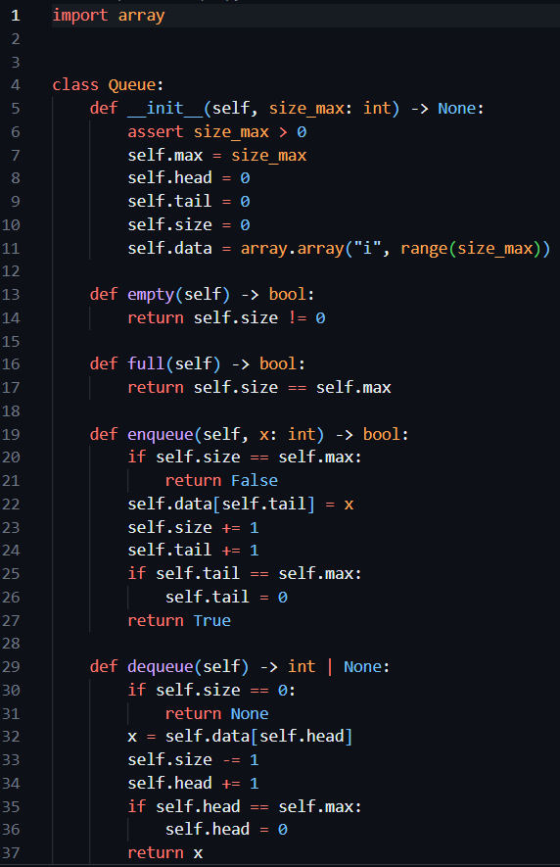

Pynguin
Now we invoke Pynguin again to generate test cases for queue class:

Slide 98
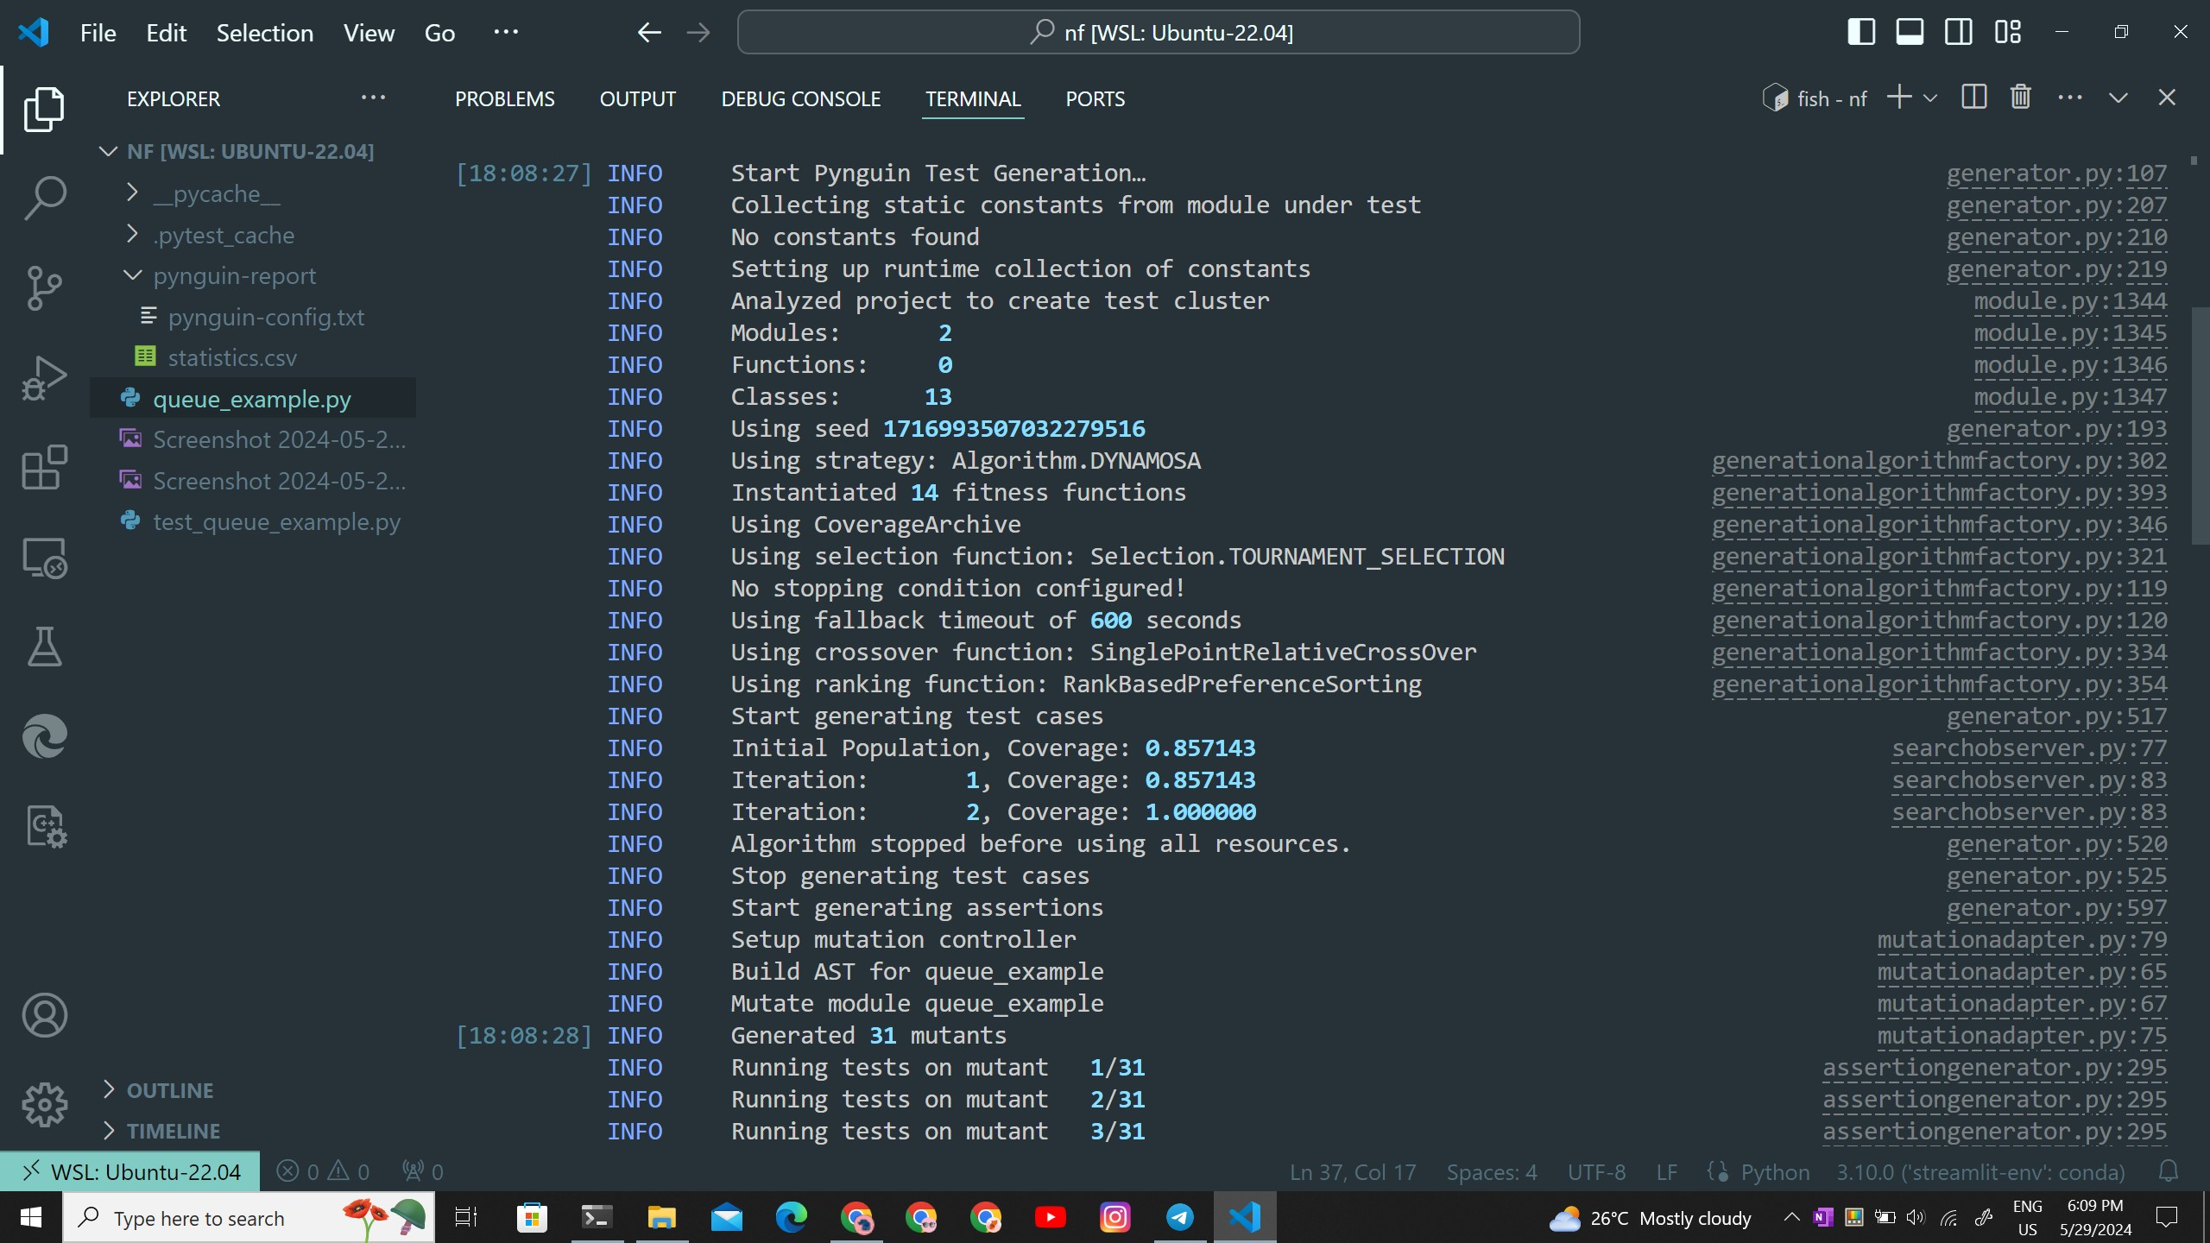
Pynguin
Pynguin report:
Project
Test generation
algorithm

Slide 99
Pynguin
Pynguin report:
Stop condition
Number of iterations
and the achieved
branch coverage

Slide 100
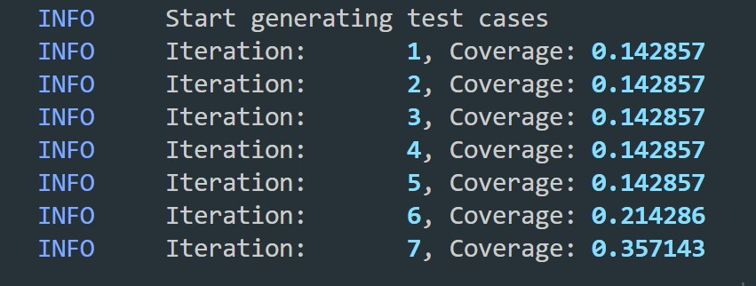
Pynguin
With each iteration the algorithm tries to increase branch coverage

Slide 101
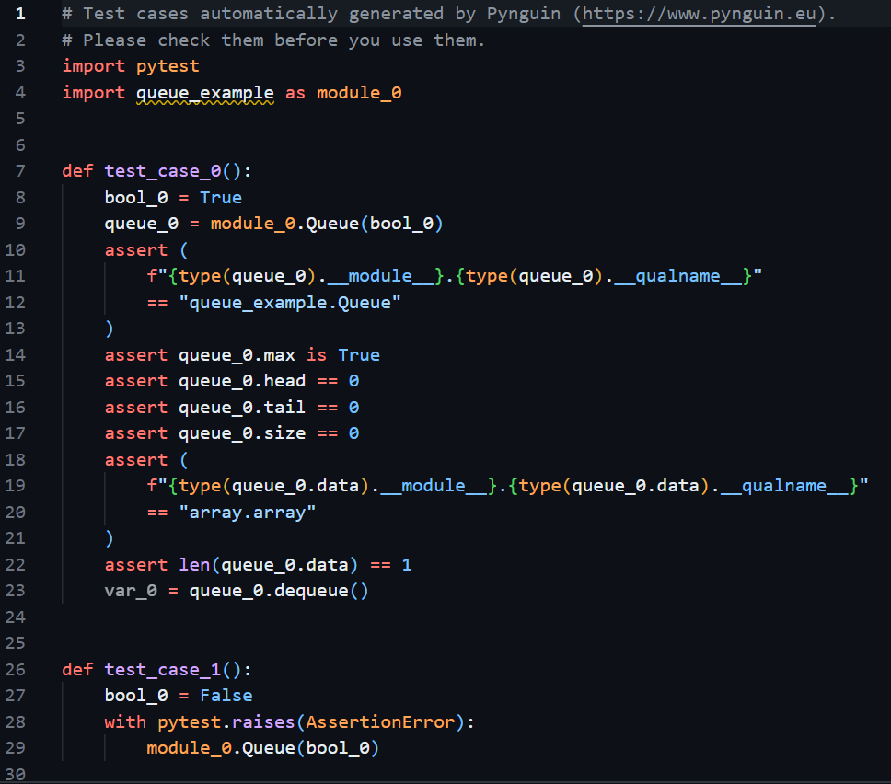
Pynguin
Output (test) file:

Slide 102
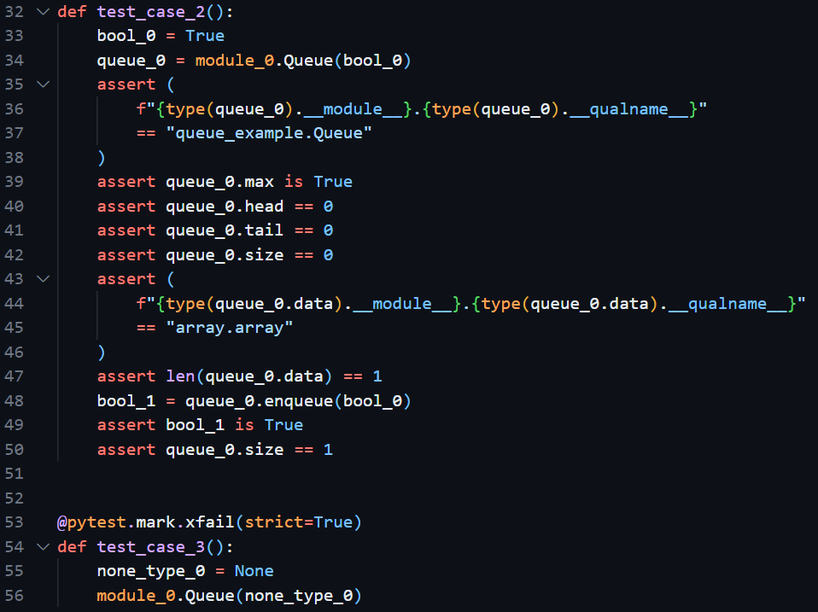
Pynguin
Output (test) file:

Slide 103
Pynguin
As you can see Pynguin generated test suite for the source code
Pynguin has a lot of parameters and configurations:
Different algorithms supported by Pynguin:
DYNAMOSA = Dynamic Many-Objective Sorting Algorithm
MIO = Many Independent Objective
MOSA = Many-Objective Sorting Algorithm
RANDOM = A feedback-direct random test generation approach similar to the algorithm proposed by Randoop
RANDOM_TEST_CASE_SEARCH = Performs random search on test cases

Slide 104
Pynguin
RANDOM_TEST_SUITE_SEARCH = Performs random search on test suites
WHOLE_SUITE = A whole-suite test generation approach similar to the one proposed by EvoSuite
DYNAMOSA is the default test generation algorithm of Pynguin
Different approaches for assertion generation supported by Pynguin:
CHECKED_MINIMIZING = All assertions that do not increase the checked coverage are removed
MUTATION_ANALYSIS = Use the mutation analysis approach for assertion generation

Slide 105
Pynguin
NONE = Do not create any assertions
SIMPLE = Use the simple approach for primitive and none assertion generation
You can even specify the stop condition:
stopping = Stopping configuration
The different available coverage metrics available for optimization:
BRANCH = Calculate how many of the possible branches in the code were executed
CHECKED = Calculate how many of the possible lines in the code are checked by an assertion
LINE = Calculate how many of the possible lines in the code were executed

Slide 106
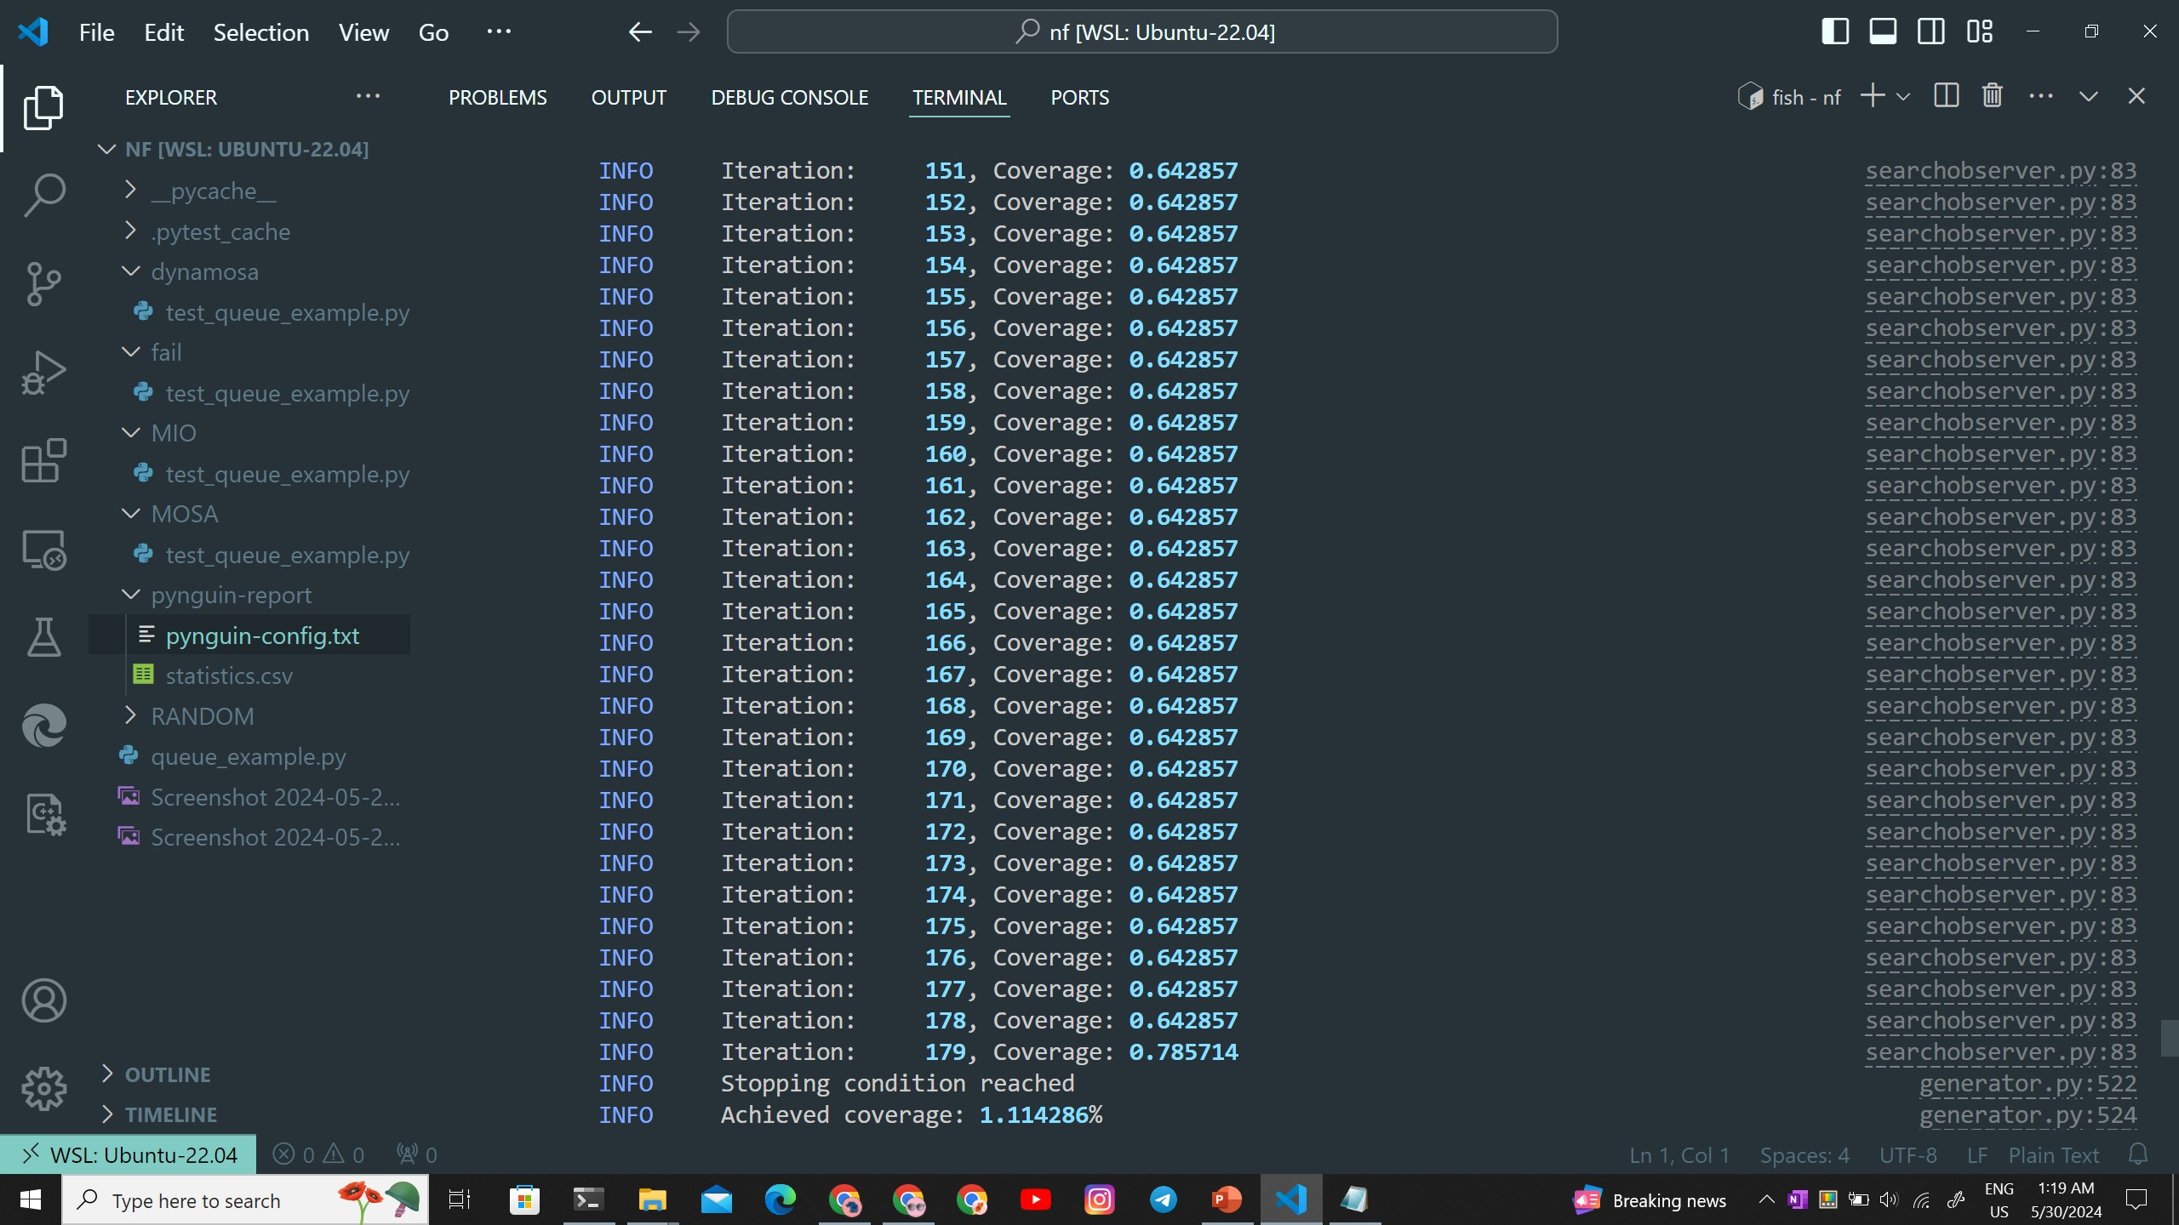
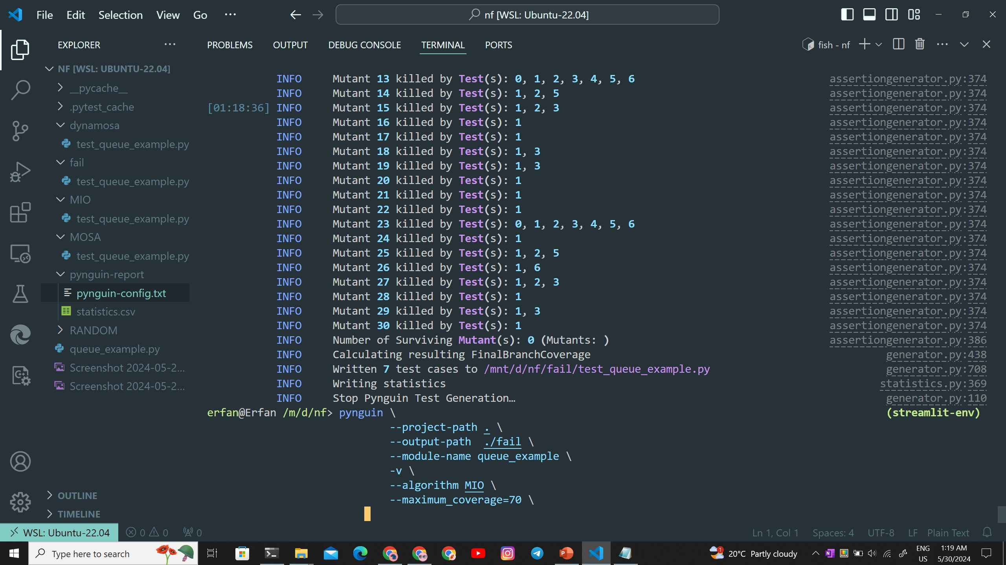
Pynguin
We set maximum coverage = 70
Algorithm = MIO

Slide 107
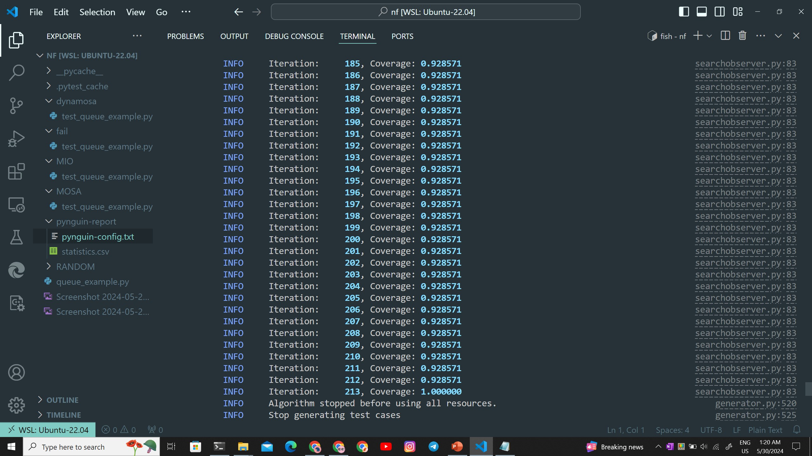
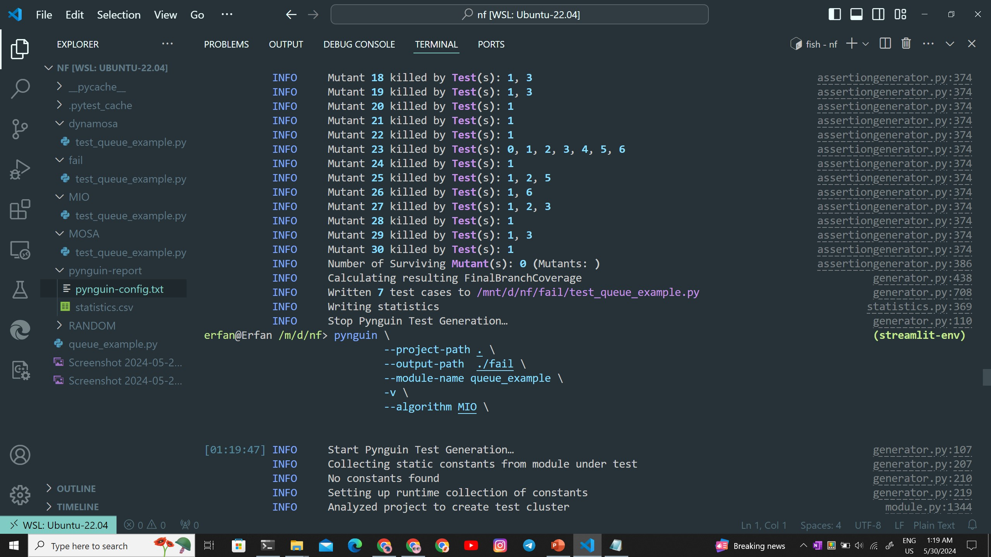
Pynguin
Without maximum coverage:

Slide 108
Mutation Testing
After reaching the set coverage metric, Pynguin tries to eliminate irrelevant test cases using Mutation Analysis (Mutation Testing)
Mutation testing is done by selecting a set of mutation operators and then applying them to the source program one at a time
The result of applying one mutation operator to the program is called a mutant
If the test suite is able to detect the change (one of the tests fails), then the mutant is said to be killed

Slide 109
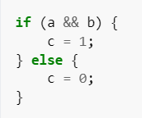
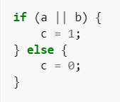
Mutation Testing
For example, consider the following C++ code fragment
We replace && with || and produce the following mutant:
A test must reach the mutated statement
Test input data should infect the program state by causing different program states for the mutant and the original program (a=1, b=0)
The incorrect program state (the value of 'c') must propagate to the program's output
Only if there is a mutant that violates an assertion, the assertion is seen as relevant

Slide 110
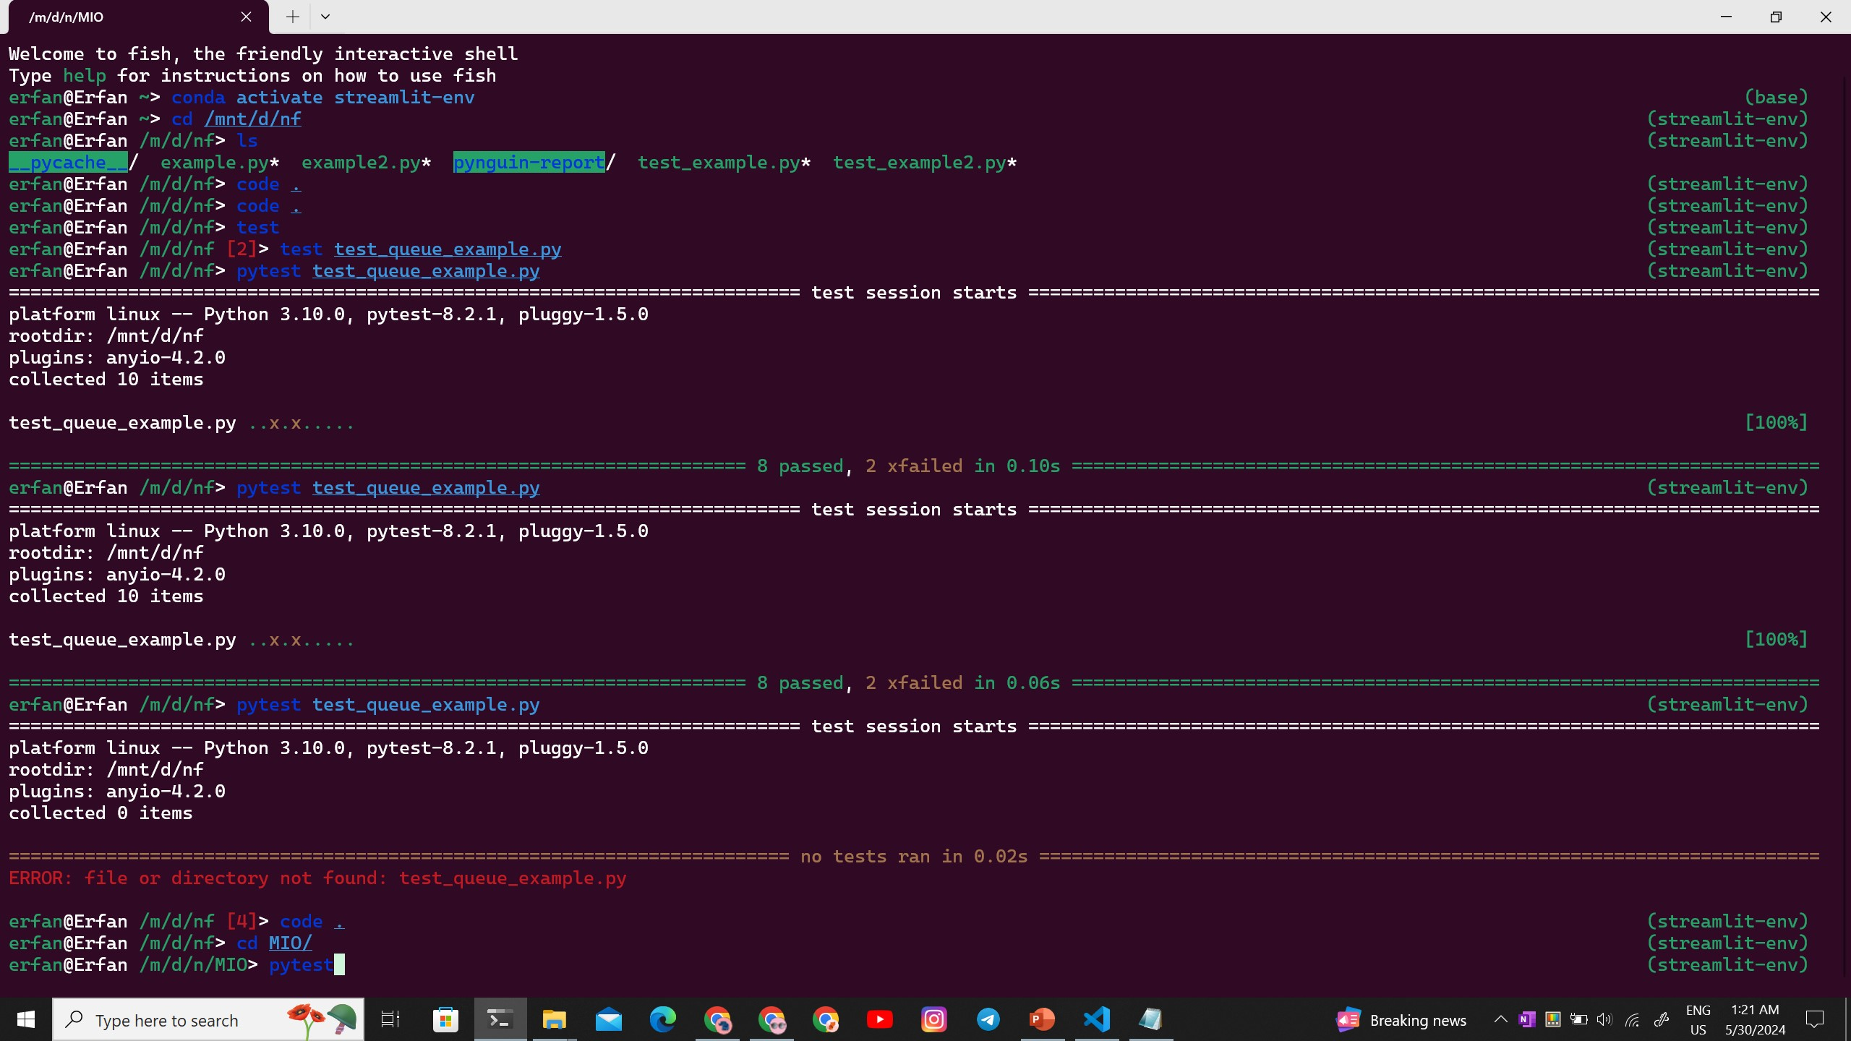
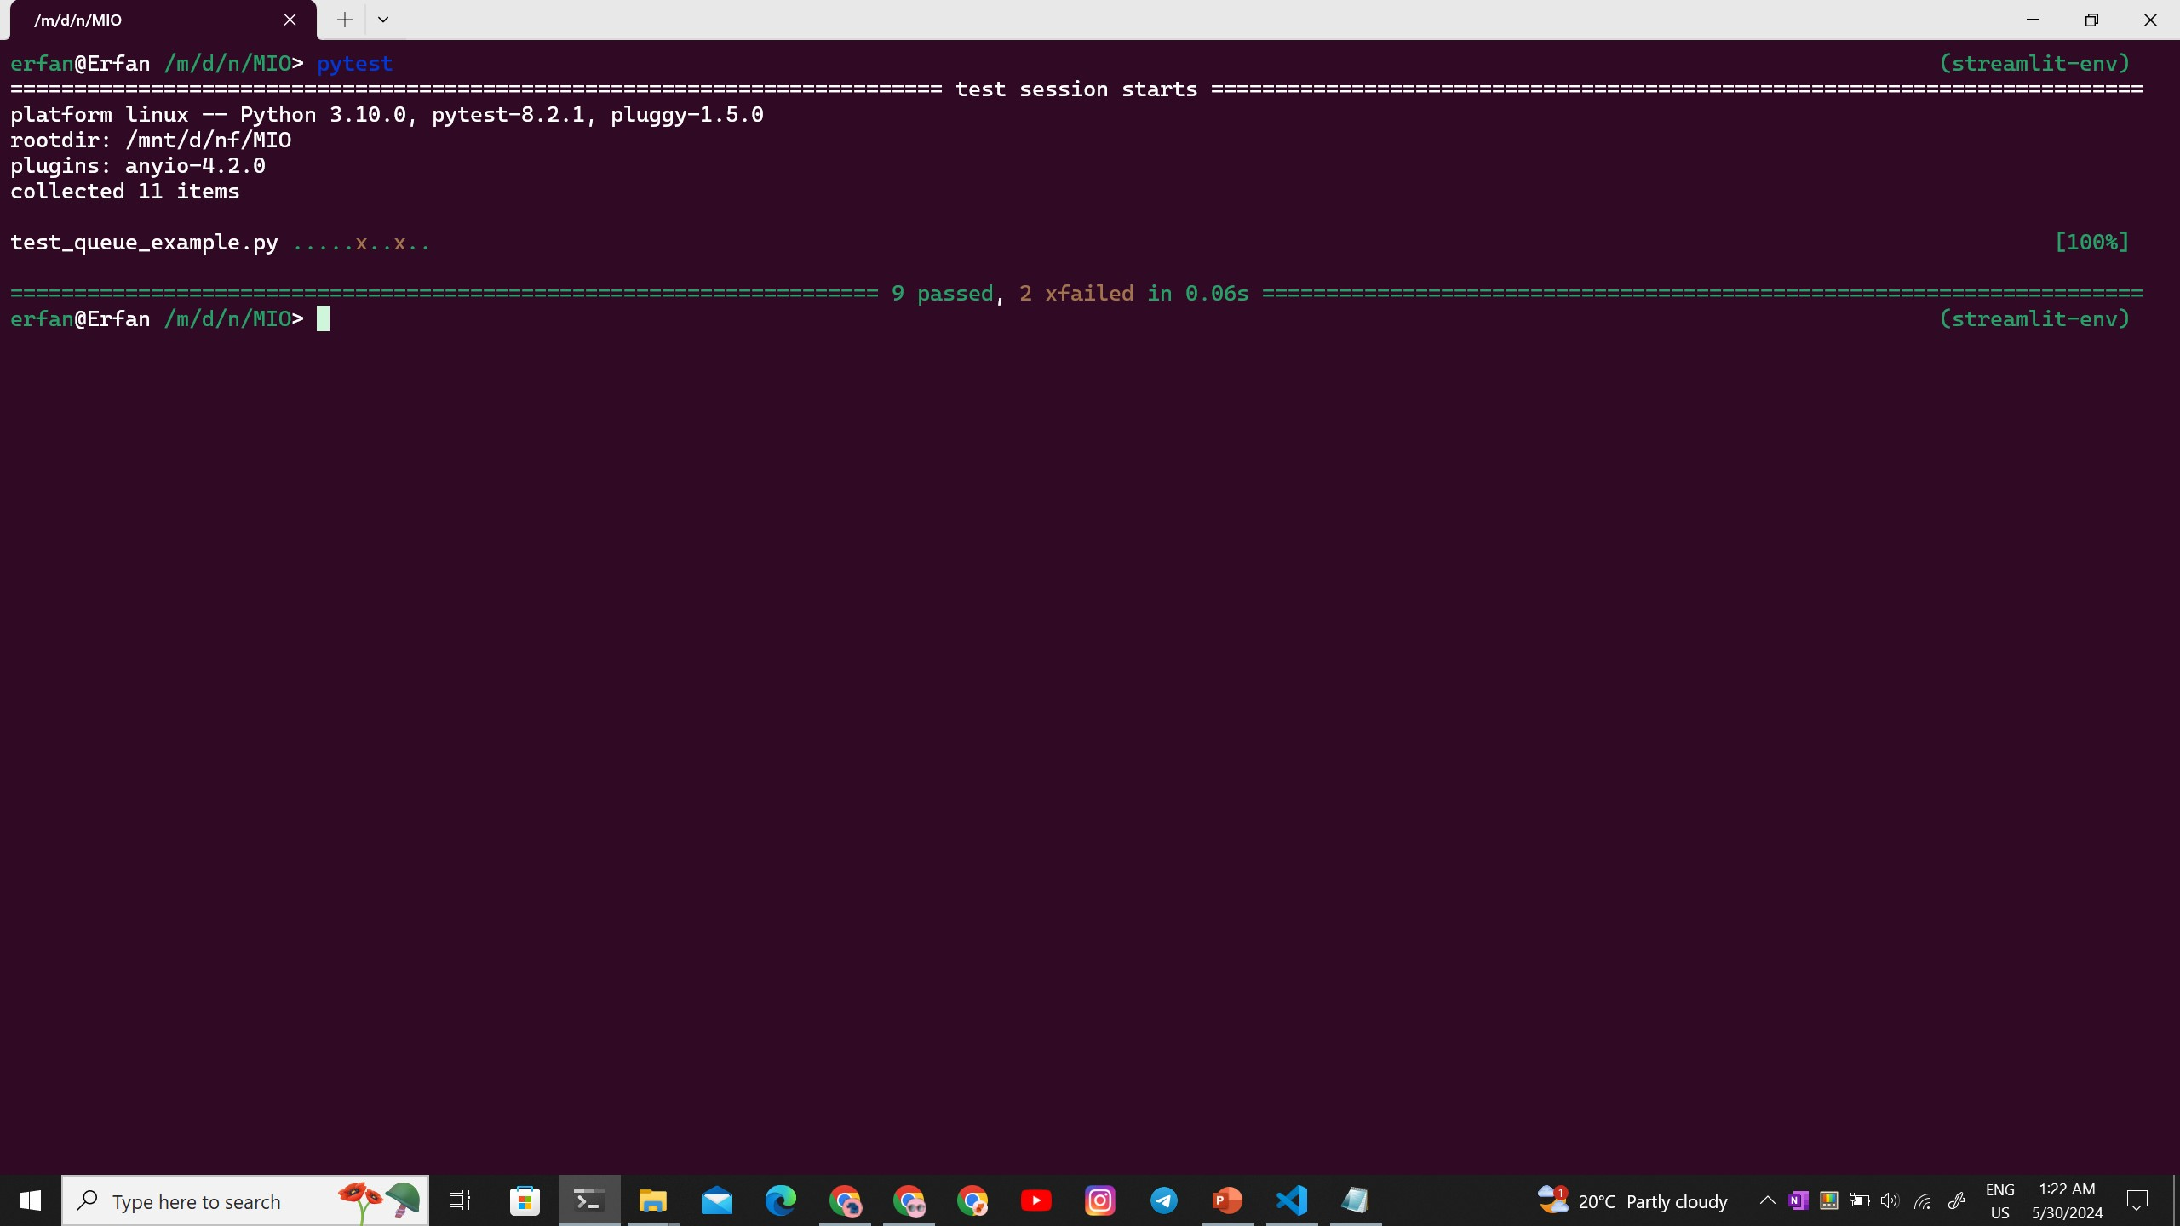
Pynguin
Pynguin exports the generated test cases in the style of the PyTest framework
We can use PyTest to run generated test file
PyTest report:

Slide 111
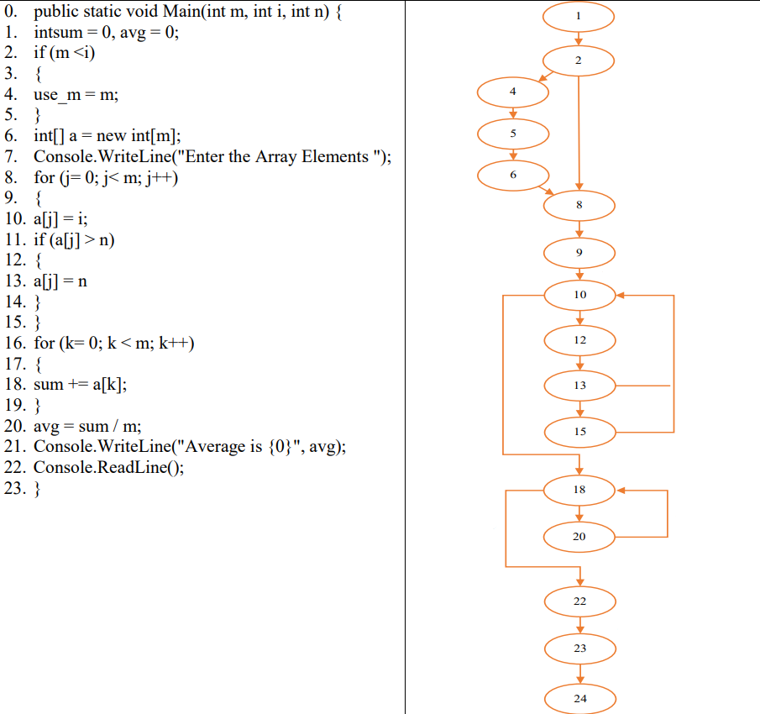
Questions
Assign weight to the following CFG using genetic algorithm. Click for Answer

Slide 112
Questions
Using genetic algorithm find a dataset for optimal branch coverage. Do one crossover and ignore mutations. Click for Answer
What are the three conditions that determine whether a test is valid or not? Click for Answer

Slide 113
References
[1] P. McMinn, “Search-Based Software Testing: Past, Present and Future,” International Conference on Software Testing, Verification and Validation Workshops, Mar. 2011, doi: https://doi.org/10.1109/icstw.2011.100.
‌ [2] M. Khari and P. Kumar, “An extensive evaluation of search-based software testing: a review,” Soft Computing, vol. 23, no. 6, pp. 1933–1946, Nov. 2017, doi: https://doi.org/10.1007/s00500-017-2906-y.
‌ [3] Konstantin Serdyukov and T. Avdeenko, “Using genetic algorithm for generating optimal data sets to automatic testing the program code,” Jan. 2019, doi: https://doi.org/10.18287/1613-0073-2019-2416-173-182.
[4] “Introduction to Hill Climbing | Artificial Intelligence,” GeeksforGeeks, Dec. 12, 2017. https://www.geeksforgeeks.org/introduction-hill-climbing-artificial-intelligence/
‌[5] “Pynguin—PYthoN General UnIt test geNerator — pynguin 0.36.0.dev documentation,” pynguin.readthedocs.io. https://pynguin.readthedocs.io/en/latest/ (accessed Jun. 02, 2024).

